Slide 1


Producing a Pharmaceutical or Biopharmaceutical
The Manufacturing Process

Slide 2
Process development
Scientists and engineers begin to figure out how to “scale up” production of a drug even before it receives FDA approval.
Manufacturing processes might be quite different than the small-scale lab procedures.

Slide 3
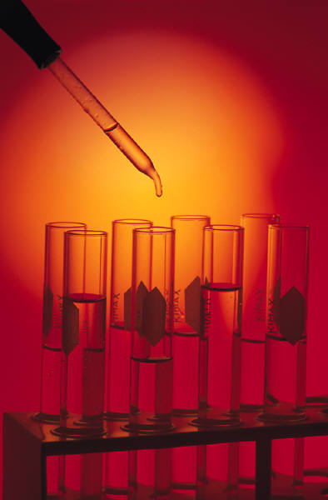
Production
Production of a pharmaceutical or biopharmaceutical involves many different, complex and lengthy steps:
  Synthesis (chemical or cell culture)
  Purification
  Formulation
  Final dosage form preparation

Slide 4

Step 1: Synthesis
Order the raw materials needed to make the product.
Test all raw materials to be sure they meet quality standards.
For biomanufacturing, equipment and materials need to be sterilized to avoid bacterial and other contamination to the cell cultures.

Slide 5
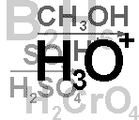
Step 1: Synthesis
The product then is created.
  For pharmaceuticals, there are chemical processes involved (chemical synthesis).
  For biopharmaceuticals, cell culture or fermentation is involved.
  The product is referred to as the “active ingredient.”

Slide 6
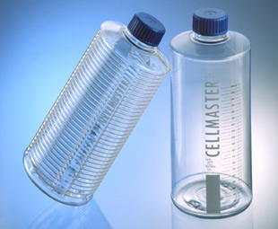
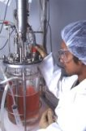
Step 1: Synthesis
For the biopharmaceutical, the original cell culture is started in small bottles (around the size of large soda bottles)
As the cells grow and multiply, they are introduced into a small bioreactor.
Eventually they are grown in large bioreactors, which can be several stories tall!

Slide 7
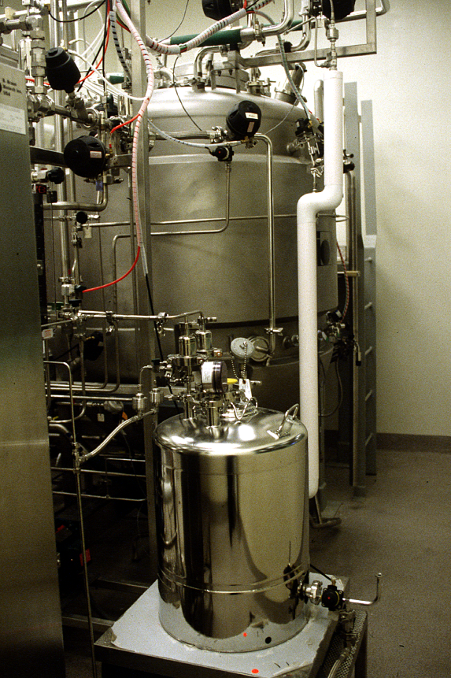
Step 1: Synthesis
A small bioreactor in the foreground with a larger bioreactor behind it.

Slide 8
Step 2: Purification
After the active ingredient is synthesized, it must be purified.
Purification involves removing the chemicals used in the process.
For biopharmaceuticals, purification involves separating the cells from the cellular nutrients and byproducts (the “soup”) they grew in.

Slide 9
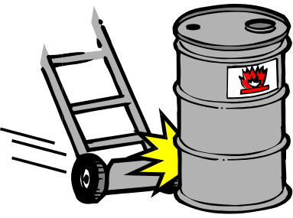
Step 2: Purification
The end result of production is called the bulk product.
The bulk product may be sold as is, processed further at the same plant or shipped to another plant for further processing.

Slide 10

Step 3: Formulation
Several other operations are required to get bulk product into its final form.
Formulation involves chemical mixing operations to blend the active ingredient with other substances, such as fillers, needed in the final form.

Slide 11
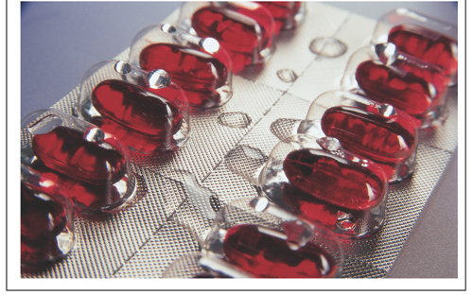
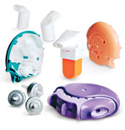
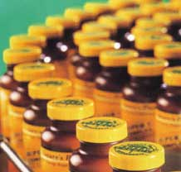
Step 3: Formulation
The final form may be a solid (tablet or capsule), liquid, gels/creams or aerosols.
Biopharmaceuticals usually are sold as sterile liquids or sterile powders.

Slide 12
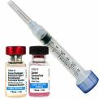

Step 4:
Final dosage form preparation
The formulated preparation is made into its final form.
The final form is dispensed into containers.
The containers are labeled and packaged.

Slide 13
Quality matters
The standards of quality are high because the stakes are high.
Poor quality products can harm or even kill consumers.
Companies must conform to the stringent Good Manufacturing Practice (GMP) regulations established by the FDA.

Slide 14
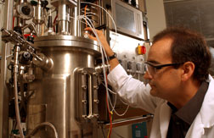
Ensuring quality
Manufacturers have three departments that ensure quality:
  Quality control (QC)
  Quality assurance (QA)
  Validation

Slide 15
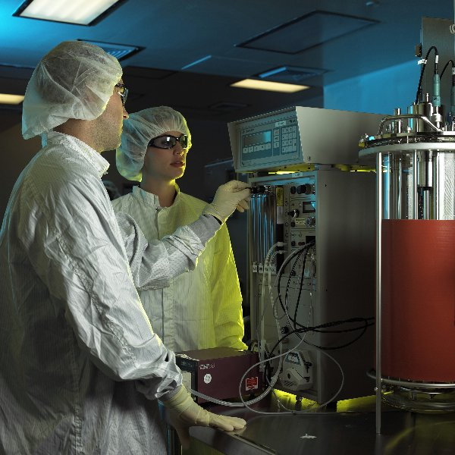
Quality control
QC employees sample and test the raw materials and the product during many stages of the manufacturing process.

Slide 16
Quality assurance
QA ensures product quality by setting up and checking the systems of standard operating procedures (SOPs) and of documentation.
SOPs guide every task by defining each procedure in detail so it can be performed exactly the same way every time.

Slide 17

Quality assurance
Companies are required to prepare and follow SOPs by the FDA.
Any deviation from the SOP must be documented and approved by the QA department.
Critical deviations that could affect product quality are investigated further.

Slide 18

Quality assurance
Documentation proves that a company has done what it said.
A company is required to have a traceable, written record of all processes and checks.
“If it isn’t written down, it doesn’t exist. If it isn’t written down, it never happened.”

Slide 19
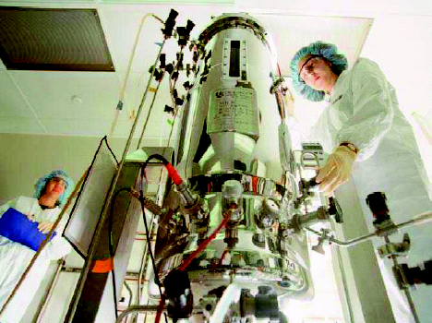
Validation
Validation proves that a manufacturing process will consistently produce the product to predefined specifications.
The operation of every part of the plant that affects quality must be validated.

Slide 20

Validation
If a manufacturing process is changed or if a new product is introduced, all processes and equipment that affect quality must be validated.
Validation scientists and engineers have extensive experience because they must be very familiar with the regulations.

Slide 21

Five Rules for Quality
1. Understand customer needs
  Companies have internal customers (fellow employees) as well as external customers.
  For a process technician, your internal customer is your coworker at the next stage of the process.

Slide 22

Five Rules for Quality
2. Say what you do (write down procedures)
  Standard procedures and forms are required for every step.
  Batch records define the steps required to manufacture the product, the materials used, etc.

Slide 23

Five Rules for Quality
3. Do what you say (follow procedures)
  Manufacturers are required to consistently and exactly follow procedures.
  SOPs are vital, and there are SOPs for every step.

Slide 24

Five Rules for Quality
4. Prove it (keep records)
  Companies must have traceable, written records of all processes.
  Remember: “If it isn’t written down, it doesn’t exist. If it isn’t written down, it never happened.”

Slide 25
Five Rules for Quality
5. Improve it
  Companies must continually evaluate its processes and procedures.
  They should take steps to make the product and process better.
  Of course, new procedures must be validated!

Slide 26
Standard Operating Procedures
SOPs define a particular process in detail so it can be performed the same way, every time.
Lengthy regulations related to manufacturing are found in the Code of Federal Regulations.
Good Manufacturing Practice (GMP) regulates methods, equipment, facilities and controls.

Slide 27

What is included in SOPs?
Effective date
Purpose
Scope
Safety
Responsibility
References (other SOPs)
Materials and equipment
Procedures
Approval

